Slide 1
Advanced operating System
Unit-3
Memory and Input/Output Management

Slide 2
Memory Management
The program and data of a process must be in main memory for the process to execute.
How to keep the track of processes currently being executed?
Which processes to load when memory space is available?
How to load the processes that are larger than main memory?
How do processes share the main memory?
OS component that is responsible for handling these issues is a memory manager.

Slide 3
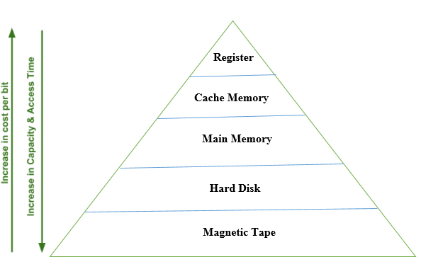
Memory Hierarchy
The Computer memory hierarchy looks like a pyramid structure which is used to describe the differences among memory types.
In Memory Hierarchy the cost of memory, capacity is inversely proportional to speed.

Slide 4
Registers
The registers are present inside the CPU. As they are present inside the CPU, they have least access time. Registers are most expensive and smallest in size generally in kilobytes
Cache memory
It is a very high speed semiconductor memory which can speed up the CPU. It acts as a buffer between the CPU and the main memory
It is expensive and smaller in size generally in Megabytes
Main Memory
It directly communicates with the CPU and with auxiliary memory devices through an I/O processor. Main memory is less expensive than cache memory and larger in size generally in Gigabytes.
Hard Disk
They are used as backup storage. They are cheaper than main memory and larger in size generally in a few TB.
Magnetic Tape
They are used to store removable files and are the cheapest and largest in size

Slide 5
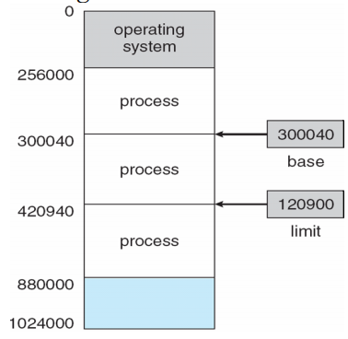
Memory Management Requirements
Relocation
Programmer does not know where the program will be placed in memory when it is executed
While the program is executing, it may be swapped to disk and returned to main memory at a different location (relocated)
Memory addresses must be translated in the code to actual physical memory address.
Hardware used - Base register, limit register
Base register: Holds smallest legal physical memory address.
Limit register: contain the size of range.
Example:
logical address = 300
if Base = 1500
physical address = 1500 + 300 = 1800.

Slide 6
Protection
Prevent processes from interfering with the OS or other processes.
Processes should not be able to reference memory locations in another process without permission.
Impossible to check absolute addresses in programs since the program could be relocated.
Often integrated with relocation.
Sharing
• Allow several processes to access the same portion of memory (allow to share data).
• Better to allow each process (person) access to the same copy of the program rather than have their own separate copy.

Slide 7
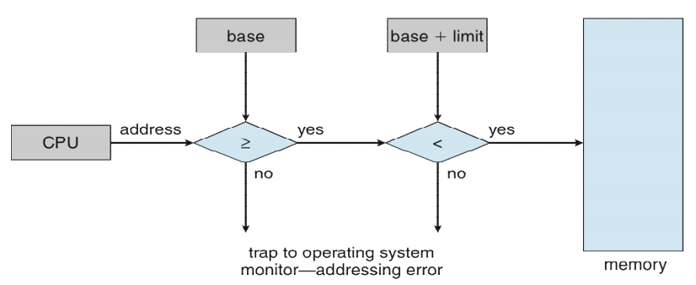
Address Protection with Base and Limit Registers
CPU compare every address generated in user mode with the base registers. Any attempt by a program executing in user mode to access operating-system memory or other users' memory results in a trap to the operating system, which treats the attempt as a fatal error

Slide 8
Logical vs. Physical Memory Address Space
Logical Address: The address generated by CPU. Also known as virtual address.
Physical Address: Actual address loaded into the memory address register.
The set of all logical addresses generated by a program is a logical address space; the set of all physical addresses corresponding to these logical addresses is a physical address space.
Mapping from logical address to physical address is relocation.
Two registers: Base (relocation) and Limit are used in mapping.
Hardware device that maps virtual to physical address at run time is Memory Management Unit(MMU)

Slide 9
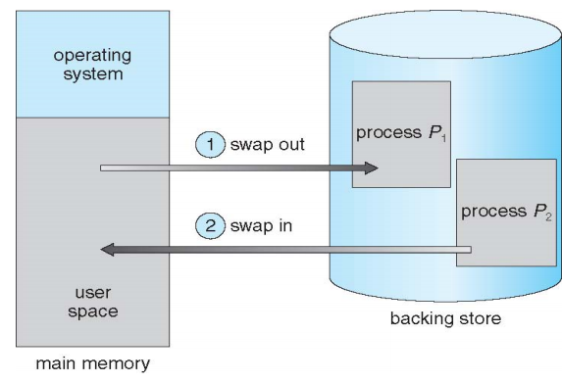
Memory management with Swapping
Swapping is mechanism in which a process can be swapped temporarily out of main memory to secondary storage (disk) and make the that memory available to other processes. At some later time, the system swaps back the process from the secondary storage to main memory
In multiprogramming processes will be swapped in and out many times before its completion. In some swapping systems, one processes occupies the main memory at once; when process can no longer to continue it relinquishes
It is needed when there is no enough main memory to hold all the currently active in timesharing system.

Slide 10
Memory Management With Bitmaps
Memory is divided into allocation units and each allocation unit has a bit in the bitmap.
If the bit is 0, the unit is free.
It requires less memory to store bit maps.
The main problem is that when it has been decided to bring a k unit process, the memory manager must search the bitmap to find a run of k consecutive 0 bits in the map.
Searching a bitmap for a run of a given length is a slow operation.
Memory Management With Linked List
A linked list of allocated and free memory segments is maintained.
Each entry in a list specifies a hole or process, address at which it starts, length and pointer to next entry.
Process and hole are on a list sorted by address.

Slide 11
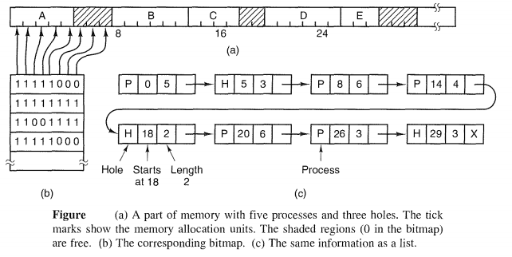

Slide 12
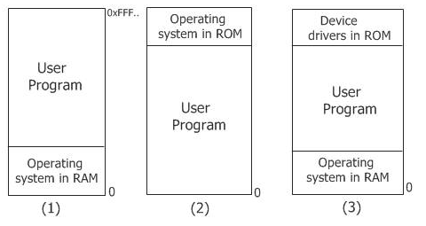
Mono programming
In this scheme, it is allowed to run only one program at a time, sharing memory between program and OS.
When user provides command, the OS copies requested program to memory form disk and executes it. As the program completes, the OS displays prompt character and waits for next command. When next command is provided, it beds new program into memory overwriting the previous program

Slide 13
Multiprogramming
In multiprogramming, multiple program reside in main memory at time.
There are two Memory Management Techniques: Contiguous, and Non-Contiguous.
In Contiguous Technique, executing process must be loaded entirely in main-memory.
Contiguous Technique can be divided into:
Fixed (or static) partitioning
Variable (or dynamic) partitioning

Slide 14
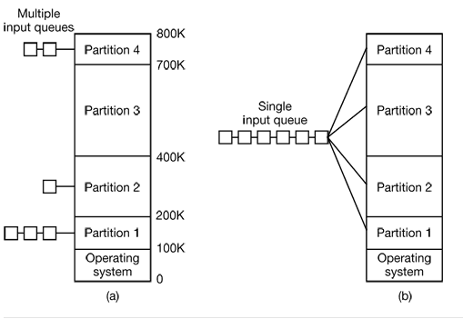
Fixed Partitioning
It is also called static partitioning scheme.
In this technique, main memory is pre-divided into fixed size partitions.
The size of each partition is fixed and can not be changed.
Each partition is allowed to store only one process.

Slide 15
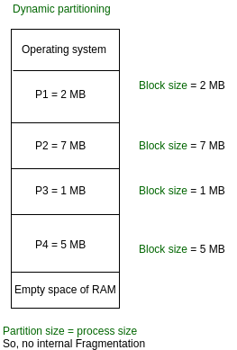
Variable Partition:
It is also called dynamic partitioning scheme.
The memory is partitioned dynamically when process comes and goes.
Initially RAM is empty and partition are made during the Run Time according to process’s need instead of partitioning during the system configure.
The size of partition will be equal to incoming process.
The number of partition in RAM is not fixed and depends on the number of incoming process and main memory.

Slide 16
Partition Selection Algorithms
First Fit:
Allocate the first hole that is big enough. It stop the searching as soon as it find a free hole that is large enough
Best Fit:
This algorithm first scan the all empty partitions. Then allocate the smallest hole that is big enough
Worst Fit:
This algorithm first scan the all empty partitions. Then allocate the largest hole.
Next Fit:
Same as first fit but start search always from the last allocated hole

Slide 17
Partition Selection Algorithms
Example1: Given memory partitions of 100K, 500K, 200K, 300K, and 600K (in order), how would each of the First-fit, Best-fit, and Worst-fit algorithms place processes of 212K, 417K, 112K, and 426K (in order)? Which algorithm makes the most efficient use of memory?
Example2: Given six memory partitions of 300 KB, 600 KB, 350 KB, 200 KB, 750 KB, and 125 KB (in order), how would the first-fit, best-fit, and worst-fit algorithms place processes of size 115 KB, 500 KB, 358 KB, 200 KB, and 375 KB (in order)?

Slide 18
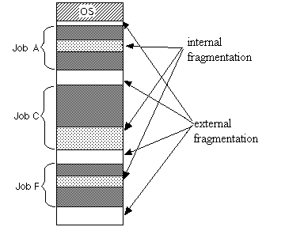
Memory Fragmentation
When holes given to other process they may again partitioned, the remaining holes gets smaller eventually becoming too small to hold new processes – waste of memory occur – memory fragmentation.
External Fragmentation – total memory space exists to satisfy a request, but it is not contiguous. Fist fit and Best Fit suffers from external fragmentation. External fragmentation can be reduced by memory compaction
Internal Fragmentation – allocated memory may be slightly larger than requested memory; this size difference is memory internal to a partition, but not being used

Slide 19
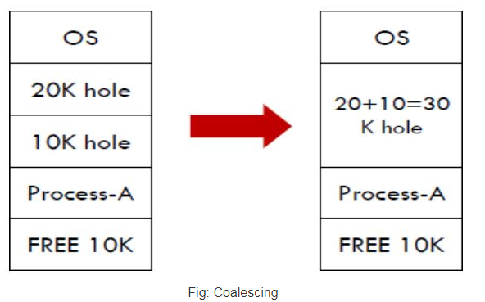
Coalescing
The process of merging two adjacent holes to form a single larger hole is called coalescing.

Slide 20
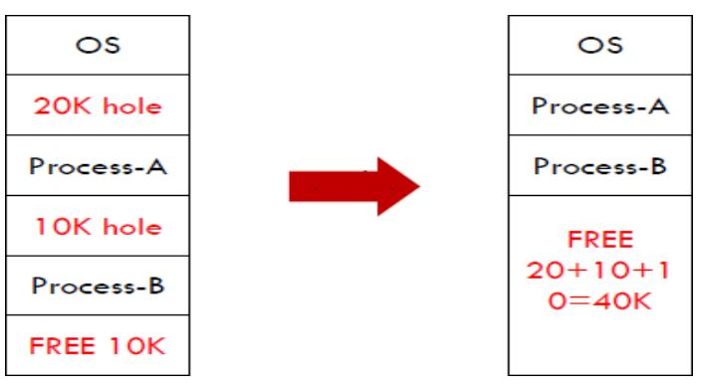
Compaction
Even when holes are coalesced, no individual hole may be large enough to hold the job, although the sum of holes is larger than the storage required for a process.
It is possible to combine all the holes into one big one by moving all the processes downward as far as possible; this technique is called memory compaction.

Slide 21
Non-contiguous memory allocation
In the non-contiguous memory allocation the available free memory space are scattered here and there and all the free memory space is not at one place
In the non-contiguous memory allocation, a process will acquire the memory space but it is not at one place it is at the different locations according to the process requirement.
This technique of non-contiguous memory allocation reduces the wastage of memory which leads to internal and external fragmentation
Non-contiguous memory allocation techniques can be two types
Paging
Segmentation

Slide 22
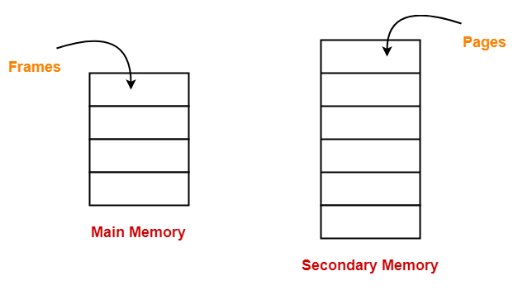
Paging
Paging is a fixed size partitioning scheme.
In paging, secondary memory and main memory are divided into equal fixed size partitions.
The partitions of secondary memory are called as pages.
The partitions of main memory are called as frames.

Slide 23
Each process is divided into parts where size of each part is same as page size.
The size of the last part may be less than the page size.
The pages of process are stored in the frames of main memory depending upon their availability.
When a process is to be executed, its pages are loaded into any available memory frames from the backing store.
The size of the pages is determined by the hardware, normally from 512 bytes to 16MB (in power of 2).
Paging permits the physical address space of process to be noncontiguous.

Slide 24
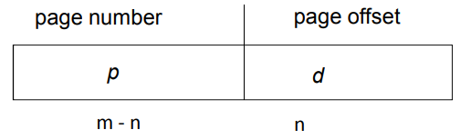
Address Translation
CPU always generates a logical address. A physical address is needed to access the main memory.
Address generated by CPU is divided into:
Page number (p) - used as an index into a page table which contains base address of each page in physical memory.
Page offset (d) - combined with base address to define the physical memory address that is sent to the memory unit.
If the size of the logical address space is 2^m and page size is 2^n, then the high-order m - n bits of logical address designate page number, and n lower order bits designate the page offset.
Present/absent bit keeps the track of which pages are physically present in memory

Slide 25
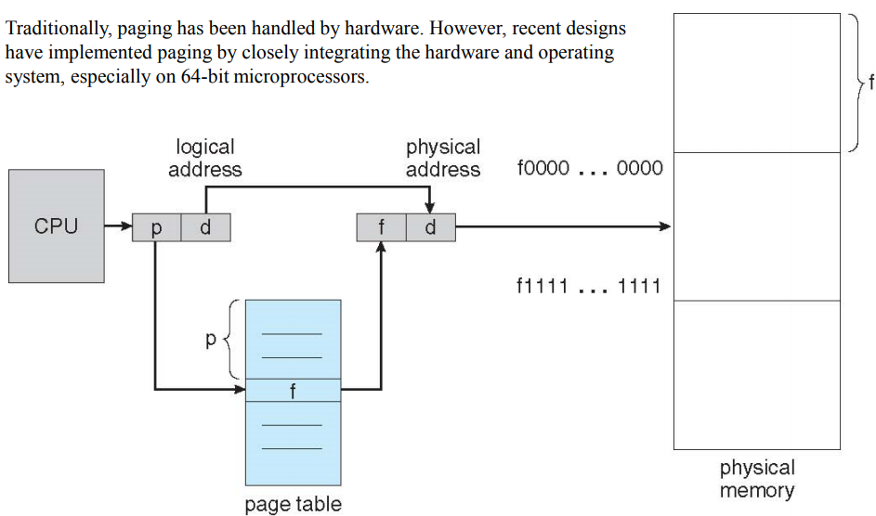

Slide 26
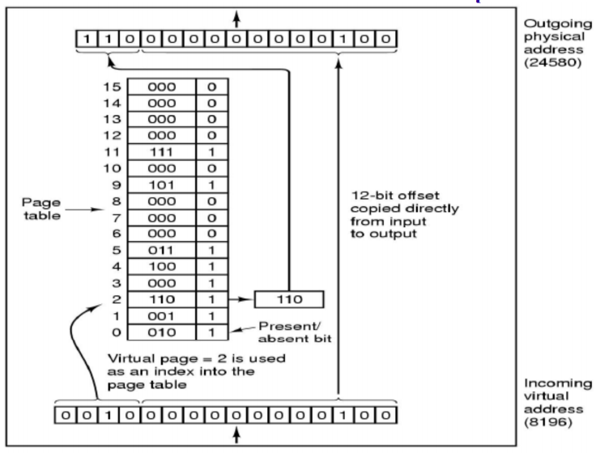
Address Translation Example

Slide 27
Virtual Memory
Virtual memory is a memory management capability of an operating system that uses hardware and software to allow computer to compensate for physical memory shortages by temporarily transferring data from random access memory (RAM) to disk storage.
When the memory is small and data is big then we can use virtual memory concept.
The basic idea behind the virtual memory is that the combined size of the of the program, data, and stack may exceed the amount of physical memory available for it. The OS keeps those part of the program currently in use in main memory, and the rest on the disk.
Virtual memory is a concept that is associated with ability to address a memory space much larger than that the available physical memory.

Slide 28
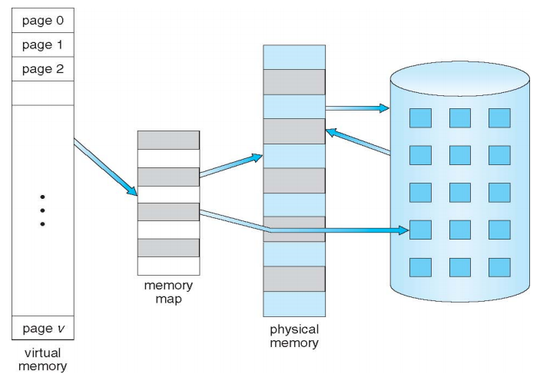

Slide 29
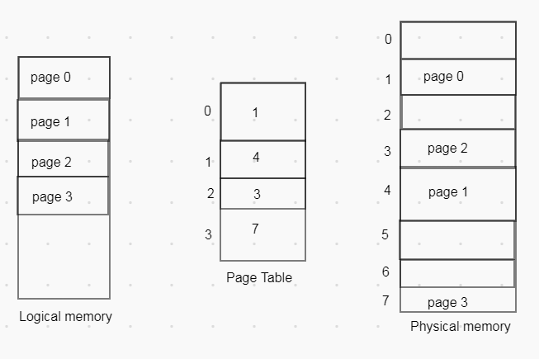
Page Table
A page table is the data structure used by virtual memory system in a computer operating system to store mapping between virtual address and physical address
Page table is kept in main memory.
Number of entries in a page table = Number of pages in which the process is divided.
Page Table Base Register (PTBR) contains the base address of page table.
Each process has its own independent page table.

Slide 30
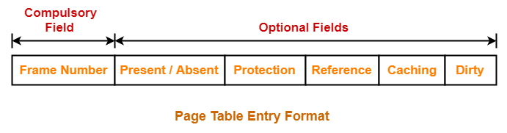
Page table Structure
The exact layout of page table entry is highly machine dependent, but more common structure for 32-bit system is as:
Frame number: specifies the frame where the page is stored in the main memory.
Present/absent bit: If present/absent bit is present, the virtual addresses is mapped to the corresponding physical address. If present/absent is absent the trap is occur called page fault.

Slide 31
Protection bit: Tells what kinds of access are permitted read, write or read only.
Referenced bit: set whenever a page is referenced; used in page replacement.
Caching disabled: used for that system where the mapping into device register rather than memory.
Modified bit (dirty bit): Identifies the changed status of the page since last access; if it is modified then it must be rewritten back to the disk.

Slide 32
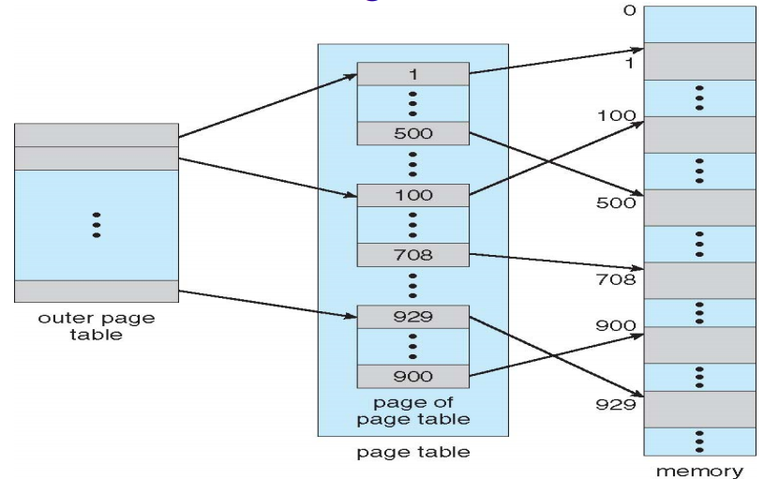
Types of page table
Hierarchical Page table:
It is also known as multi-level paging
Break up the logical address space into multiple page tables.
A simple techniques is two-level page table.

Slide 33
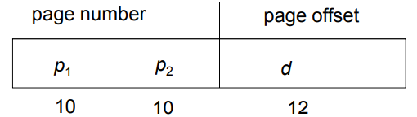
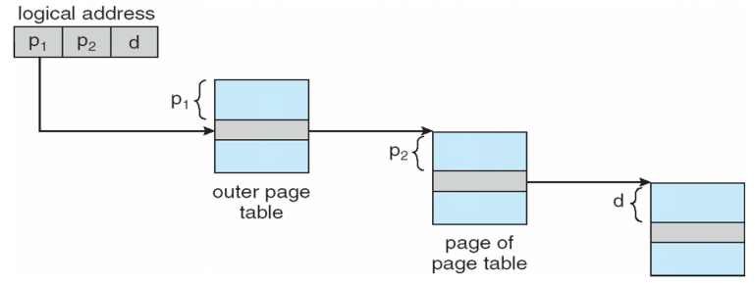
Two-Level Paging Example
A 32-bit virtual address space with a page size of 4 KB, the virtual address space is partitioned into a 10-bit P1 field, a 10-bit P2 field, and a 12-bit offset field
The top level have 1024 entries, corresponding to P1. At mapping, it first extracts the P1 and uses this value as an index into the top level page table. Each of these entries have again 1024 entries, the resulting address of top-level yields the address or page frame number of second-level page table.

Slide 34
Hashed Page Tables
A common approach for handling address space larger than 32-bit.
The hash value is the virtual-page number. Each entry in the hash table contains a linked list of elements that hash to the same location.
Each element consists of three fields:
virtual-page-number,
value of mapped page frame, and
pointer to the next element.
The virtual address is hashed into the hash table, if there is match the corresponding page frame is used, if not, subsequent entries in the linked list are searched.

Slide 35
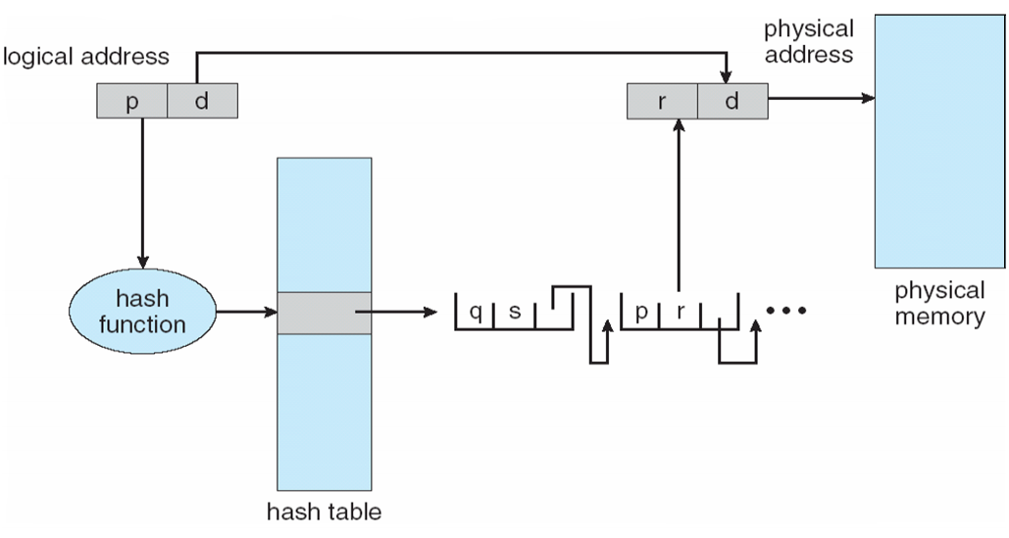

Slide 36
Inverted Page Tables
A common approach for handling address space larger than 32-bit. One entry per page frame, rather than one entry per page in earlier tables. (Ex: 256MB RAM with 4KB page requires only 65,536 entries in table)
Entry consists of the virtual address of the page stored in that physical memory location, with information about the process that owns that page.
Virtual address consists three fields: [process-id, page-number, offset].
The inverted page table entry is determined by [process-id, page-number].
The page table is search for the match, say at entry i the match is found, then the physical address [i, offset] is generated.
Decreases memory needed to store each page table, but increases time needed to search the table when a page reference occurs

Slide 37
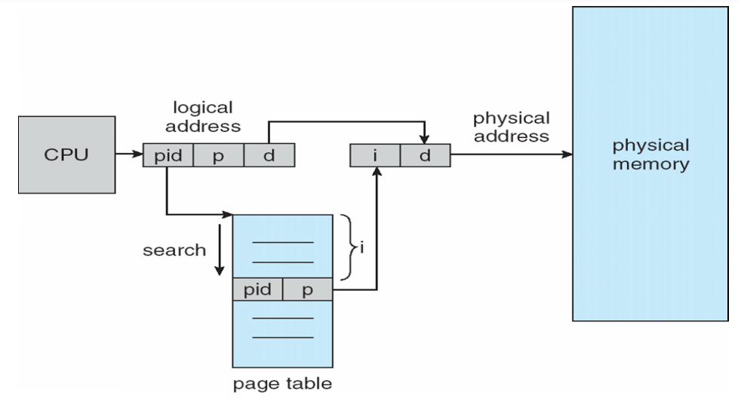

Slide 38
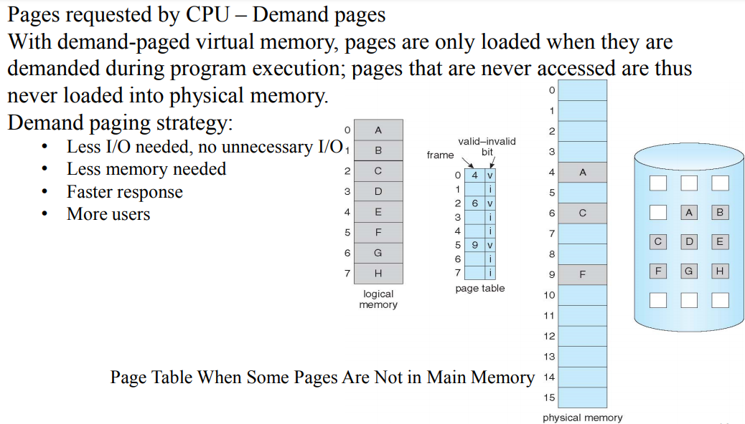
Demand Paging

Slide 39
Page Fault
When a page referenced by the CPU is not in main memory, it is called a page fault.
When a page fault occurs, the required page has to be fetched from secondary memory into main memory.
Page fault can be handled by operating System.
1.The paging hardware, in translating the address through the page table, will notice that the invalid bit is set, causing a trap to the operating system.
2. Operating system looks at another table to decide:
• Invalid reference => abort
• Just not in memory
3. Get empty frame
4. Swap page into frame via scheduled disk operation
5. Reset tables to indicate page now in memory. Set validation bit = v
6. Restart the instruction that caused the page fault

Slide 40
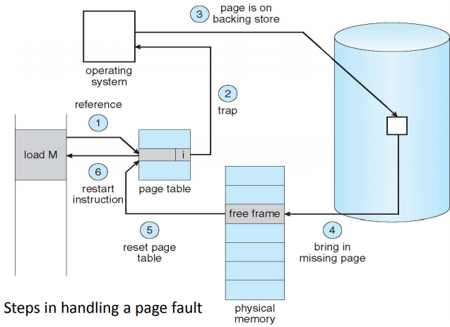

Slide 41
Page Replacement
What Happens if There is no Free Frame?
The OS has to choose a page to remove from memory to make the room for the page that has to be brought in.
Which one page to be removed ?
What happen if the page that required next, is removed?
Principle of Optimality: To obtain optimal performance the page to replace is one that will not be used for the furthest time in the future

Slide 42
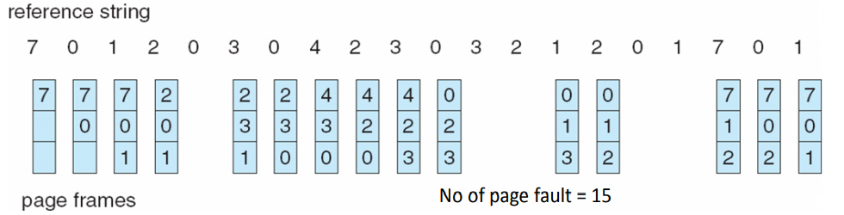
First-In-First-Out (FIFO) Algorithm
This associates with each page the time when that page was brought into the memory. The page with highest time is chosen to replace.
This can also be implemented by using queue of all pages in memory.
Example: Reference string: 7,0,1,2,0,3,0,4,2,3,0,3,0,3,2,1,2,0,1,7,0,1 3 frames (3 pages can be in memory at a time per process)
Advantages: Easy to understand and program. Distributes fair chance to all.
Problems: FIFO is likely to replace heavily (or constantly) used pages and they are still needed for further processing.

Slide 43
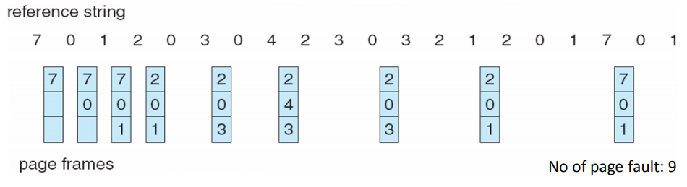
Optimal Page Replacement (OPR)
Replace the page that will not be used for the longest period of time.
Each page can be labeled with number of instructions that will be executed before that page is first referenced.
Ex: For 3 - page frames and 8 pages system the optimal page replacement is as:
Advantages: An optimal page-replacement algorithm; it guarantees the lowest possible page fault rate.
Problems: Unrealizable, at the time of the page fault, the OS has no way of knowing when each of the pages will be referenced next. This is not used in practical system.

Slide 44
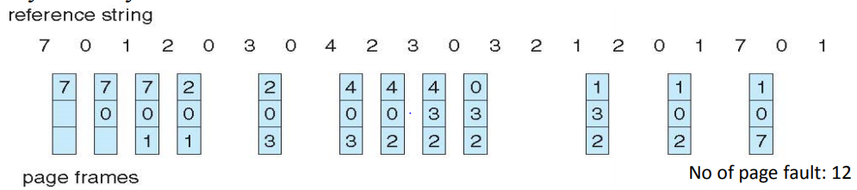
Least Recently Used (LRU) Algorithm
Recent past is a good indicator of the near future.
When a page fault occurs, throw out the page that has been unused for longest time.
Advantages: Excellent, efficient is close to the optimal algorithm.
Problems: Difficult to implement exactly. How to find good heuristic? If it is implemented as linked list, updating list in every reference is not a way making system fast!

Slide 45
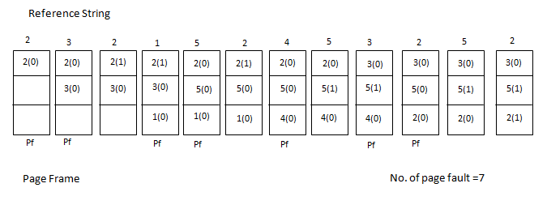
Second Chance Page Replacement
Modified Version of FIFO
Instead of swapping out the last page, the reference bit is checked.
Gives every page a “Second Chance”
Example: Reference string: 2,3,2,1,5,2,4,5,3,2,5,2 frames (3 pages can be in memory at a time per process)

Slide 46
Segmentation
Segmentation is non contiguous memory management techniques.
In which the memory is divided into variable size parts.
Each part is known as segment which can be allocated to process.
The details about each segment are stored in table called segment table.
Segment table contains mainly following information about segment.
Base: it is base address of segment.
Limit: it is Length of segment

Slide 47
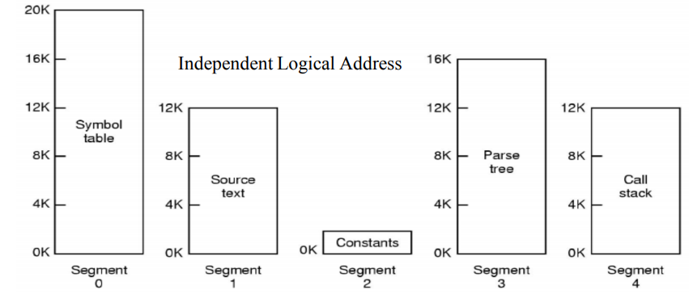
Different segments have its own name and size.
The different segment can grow or shrink independently, without effecting the others;
so the size of segment changed during execution.
For the simplicity of implementation, segments are numbered and are referred to by a segment number, rather than by segment name.
Thus the logical address consist: segment number and offset.
The segment table (like page table but each entry consist limit and base register value) is used to map the logical address to physical address

Slide 48
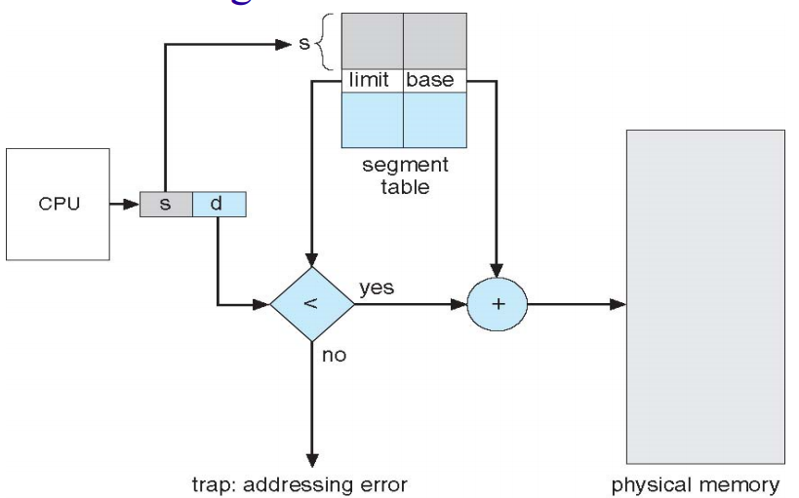
Segmentation Hardware

Slide 49
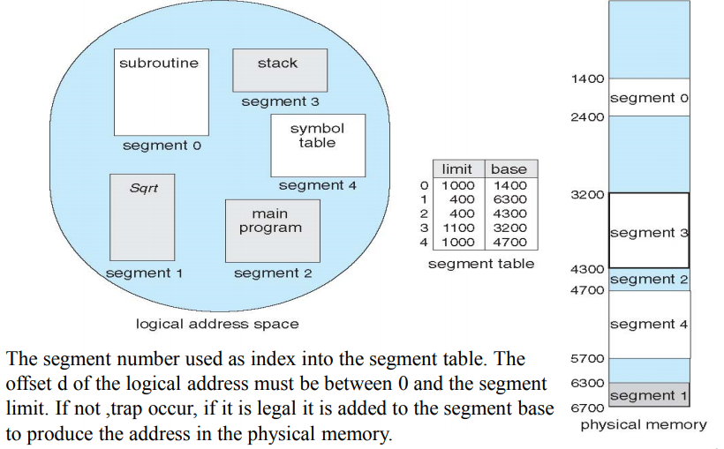
Segment Example

Slide 50
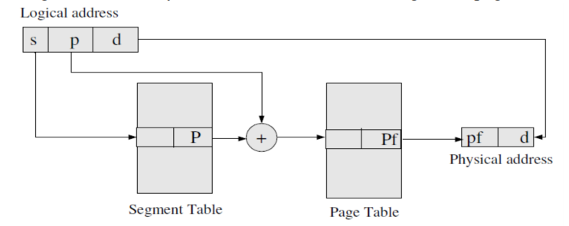
Segmentation With Paging
Pure segmentation is not popular and not being used in many of the OS
Segmentation can be combined with paging to get best feature out of both techniques.
In segmented paging, the memory is divided into fixed size pages.
Process is first partitioned into segment and then each segment is divided into pages.
The segment table entry contains the address of the segment's page table
A page table exist for each segment that keep track of frames storing pages of that segment.

Slide 51
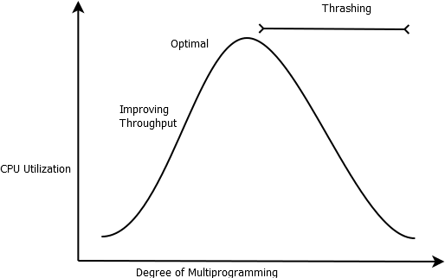
Thrashing
Thrashing is a condition or situation when the system is spending a major portion of its time in servicing page faults, but actual processing is done very negligible.
A process is said to be thrashing if it is spending more time in paging than its execution.
This results a poor throughput of the system

Slide 52
memory performance and optimization
Memory compression
Memory compression is a technique that reduces the amount of physical memory used by compressing data stored in the RAM (Random Access Memory), which allows for greater efficiency and improved system performance.
By utilizing memory compression, systems can store more information in RAM without needing to offload data to slower storage mediums like the hard drive or adding additional physical memory.
Memory compression algorithms, such as zswap and zram in Linux, are implemented at the OS level, and modern operating systems like Windows and macOS also employ memory compression to improve overall system responsiveness and performance.

Slide 53
Memory compression techniques use various compression algorithms to reduce the size of data stored in RAM.
When the system needs to access this data, it decompresses the data on-the-fly, allowing usage with minimum performance impact.
The compressed data takes up less physical memory, providing more free space for other processes and improving overall system performance.
Some benefits of memory compression are:
Improved system performance
Enhanced memory utilization
Reduced memory footprint and memory-related issues
Increased available memory for more processes
Reduced swap usage and overall I/O overhead

Slide 54
Memory deduplication
Memory deduplication is a technique used to conserve memory in a virtual environment.
It works by identifying and eliminating redundant data in memory, thereby freeing up space and increasing overall efficiency.
This is accomplished by scanning the memory for duplicate data and storing only a single copy of each data instance.
The remaining instances are then replaced with references to the original data.
This method is particularly effective in virtual environments where multiple virtual machines (VMs) may be running the same operating system or applications.
Without memory deduplication, each VM would need its own copy of the same data, leading to significant memory waste.
However, with memory deduplication, only a single copy of the data is stored, with all VMs referencing this single copy, thereby saving substantial amounts of memory.

Slide 55
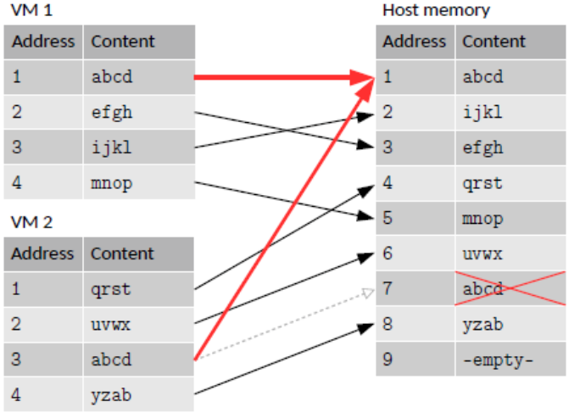
Memory deduplication Example

Slide 56
Benefits of Memory Deduplication
Reduced Memory Usage: By eliminating redundant data, memory usage is reduced, allowing more applications or VMs to run simultaneously.
Improved Performance: Less memory usage can lead to improved system performance and faster data access times.
Cost Efficiency: In cloud and virtualized environments, reduced memory consumption can lower infrastructure costs.
Problems:
Overhead: There is some overhead associated with deduplication, as the system must manage references and maintain a deduplication table.
Complexity: Implementing deduplication can add complexity to memory management and require careful tuning to balance between deduplication benefits and overhead.
Security: Ensuring that deduplication does not inadvertently expose sensitive data due to shared memory spaces.

Slide 57
Memory Tiering
Memory tiering is a strategy used in modern computer systems to optimize memory performance by organizing memory into different "tiers" based on their speed, cost, and capacity.
This approach improves overall system performance by intelligently managing how and where data is stored and accessed. Here’s a breakdown of how memory tiering enhances performance:
High-Speed Memory (Tier 1): This is typically the fastest and most expensive type of memory, such as DRAM (Dynamic RAM). It provides rapid access to data but is limited in capacity.
Intermediate-Speed Memory (Tier 2): This could include slower but larger capacity memory types like NAND flash or Intel Optane.
Low-Speed, High-Capacity Storage (Tier 3): This tier includes traditional storage solutions like HDDs (Hard Disk Drives) or large-scale SSDs (Solid State Drives) that offer high capacity at a slower access speed.

Slide 58
Input/output Device Management

Slide 59
I/O management
Generally operating system performs two main jobs:
I/O operation
Processing
The main role of operating system is to manage and control I/O operations and I/O devices.
An I/O system is required to take an application I/O request and send it to the physical device, then take whatever response comes back from the device and send it to the application.

Slide 60
Principle of I/O hardware
External device that engage in I/O with computer system can be grouped into three categories:
Machine readable or Block devices:
A block device stores information in fixed size blocks, each with its own address.
Each block can be read or written independently of other blocks
Common block size: 512-37,768 bytes
Disk drives, USB keys, Sensor, Controllers
Human readable or Character device
A character device delivers or accepts a stream of characters.
It is not addressable.
Printers, terminals , mouse, keyboard etc.
Communication device
Suitable for communicating with remote devices
Modems, digital line driver

Slide 61
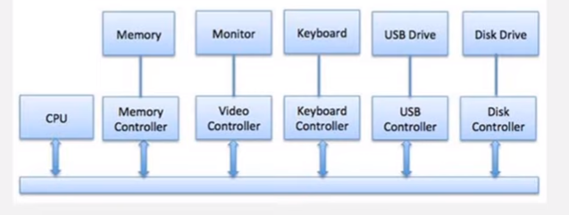
Device Controller
Device controller is an electronic component of an I/O units that provides interface between the actual device and the OS (generally CPU).
It manages the communication by managing the signals going to and coming out form the CPU.
The devices are connected to the system via a plug and socket, and the socket is connected to device controller.
OS always deals with controller.
Single bus model is used for communication between CPU and the controller.

Slide 62
Communication of CPU to I/O Device
The CPU must have a way to pass information to and from I/O devices.
There are mainly two approaches available to communicate with CPU and device.
Memory Mapped I/O
Direct Memory Access (DMA)
Memory Mapped I/O
Each controller consists of registers that is used for communicating with the CPU.
These registers can be the source on which their status can be used by OS to perform action with the device
memory mapped I/O is one of approach by which CPU communicate with registers.
It uses the same address space to address both memory and I/O devices
Only one set read and write instruction lines.
The instruction used to manipulate memory can be used for I/O.

Slide 63
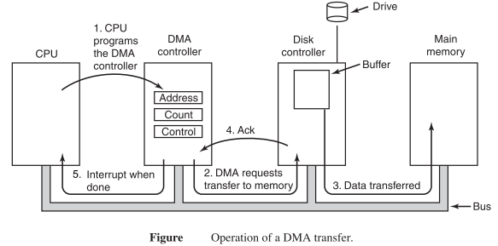
Direct Memory Access(DMA)
It is designed by Intel to transfer data at fastest rate.
It allows the device to transfer data directly to/from memory without CPU involvement.
DMA is a method that allow an I/O device to send or receive data directly to or from main memory bypassing the CPU to speed up memory operation.
The process is managed by chip is known as DMA controller.

Slide 64
CPU gives DMA controller what to transfer where.
CPU issues disk controller to read data from disk into its internal buffer and verify the checksum.
When valid data are in buffer, DMA begins.
DMA controller initiates transfer by issuing read request over to the bus to disk controller, the disk controller fetches the next word from its internal buffer.
As the controller knows where to write in memory, the fetched word is written to memory.
When write is complete, the disk controller sends acknowledgement to DMA controller over the bus.
DMA controller increments memory address to use and decrements byte count. The process is repeated until the byte count reaches 0.
DMA controller interrupts CPU to tell the transfer is complete.

Slide 65
Principle of I/O software
Goals of I/O Software
Device independence:
same program must work for different devices
Uniform Naming
Name of files or directories should not depends on device.
Error handling:
errors should be handled as close to device as possible.
Transfer type:
synchronous (blocking) or asynchronous (interrupt driven)
Sharable vs. dedicated device

Slide 66
Handling I/O
Programmed I/O
The programmed I/O was the most simple type of I/O technique for the exchanges of data or any types of communication between the processor and the external devices.
The overall operation of the programmed I/O can be summaries as follow:
The processor is executing a program and encounters an instruction relating to I/O operation.
The processor then executes that instruction by issuing a command to the appropriate I/O module.
The I/O module will perform the requested action based on the I/O command issued by the processor (READ/WRITE) and set the appropriate bits in the I/O status register.
The processor will periodically check the status of the I/O module until it find that the operation is complete.

Slide 67
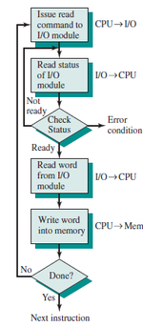

Slide 68
Interrupt driven I/O
Interrupt I/O is a way of controlling input/output activity whereby a peripheral or terminal that needs to make or receive a data transfer sends a signal
The CPU issue a command to I/O module then proceeds with its normal work until interrupted by I/O device on completion of its work.
Processor is free to do other work.
No needless waiting
Consumes a lot of processor time because every word read or write through the processor

Slide 69
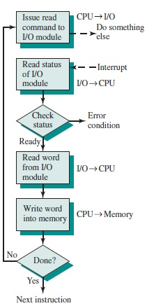

Slide 70
I/O using DMA
Direct Memory Access is a technique for transferring data within main memory and external device without passing it through the CPU.
Issue command to DMA module, by sending necessary information to DMA module.
Processor does other work.
DMA acquire control on the system, and transfers data to and from within memory and external device.
DMA sends a signal to processor when the transfer is complete, system control is return to processor.

Slide 71
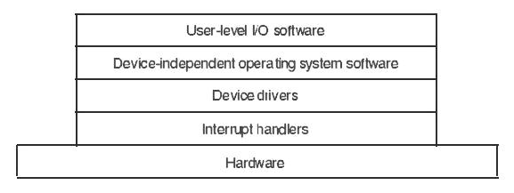
I/O Software Layers
The goals of I/O software can be achieved by modeling I/O software in four layers.
Interrupt handler
Device Driver
Device independent OS software
User level I/O software

Slide 72
Interrupt Handler
Interrupt should hidden so that system knows about them as little as possible.
Every process starting an I/O operation blocks until the I/O has completed and the interrupt occurs.
When interrupt occurs, the handler does whatever it has to in order to unlock the process that started it.
Device Drivers
Device driver consists of device dependent codes, which are installed in the kernel.
It accepts abstract request from device independent software and see that request is executed.
It must decide which controller operations are required and in what sequence.
It starts issuing commands to controller by writing into their registers.
It blocks itself until the controller performs its job and interrupt arrives.
It returns data to the caller.

Slide 73
Device Independent I/O Software
The functions of device independent software are: - a) Perform I/O functions common to all devices and to provide a uniform interface to user level software. b) It may symbolic device names onto the proper driver. c) It provides device independent block size by combining sectors into blocks. d) It performs buffering as necessity. e) It reports errors if driver cannot handle then.
User space I/O software
A small portion of I/O software consists of libraries linked together with user programs.
Spooling system keeps track of device requests mode by users.

Slide 74
I/O performance and optimization
I/O Scheduling:
To schedule a set of I/O requests means to determine a good order in which to execute them.
The order in which applications issue system calls rarely is the best choice.
Scheduling can improve overall system performance, can share device access fairly among processes, and can reduce the average waiting time for I/O to complete.
Here is a simple example to illustrate. Suppose that a disk arm is near the beginning of a disk and that three applications issue blocking read calls to that disk. Application 1 requests a block near the end of the disk, application 2 requests one near the beginning, and application 3 requests one in the middle of the disk. The operating system can reduce the distance that the disk arm travels by serving the applications in the order 2, 3, 1.
Rearranging the order of service in this way is the essence of I/O scheduling.

Slide 75
Operating-system developers implement scheduling by maintaining a wait queue of requests for each device.
When an application issues a blocking I/O system call, the request is placed on the queue for that device.
The I/O scheduler rearranges the order of the queue to improve the overall system efficiency and the average response time experienced by applications.
The operating system may also try to be fair, so that no one application receives especially poor service, or it may give priority service for delay-sensitive requests
Scheduling I/O operations is one way in which the I/O subsystem improves the efficiency of the computer

Slide 76
I/O Caching:
A cache is a region of fast memory that holds copies of data. Access to the cached copy is more efficient than access to the original.
For instance, the instructions of the currently running process are stored on disk, cached in physical memory, and copied again in the CPU’s secondary and primary caches.
Buffering and caching are very similar except that a buffer may hold the only copy of given data item where as a cache is just a duplicate copy of some other data stored elsewhere.
Caching transparently stores data in component called cache so that future request for that data can be served faster.
A cache’s sole purpose is to reduce accesses to the underlying slower storage.

Slide 77
I/O Virtualization
I/O virtualization is a technology that allows multiple virtual machines (VMs) to share the same physical resources, such as network interfaces and storage devices. It is used to improve the efficiency and flexibility of data center operations by allowing multiple VMs to share the same hardware resources.
There are different types of I/O virtualization, such as:
Network I/O virtualization: Allows multiple VMs to share the same physical network interface, by creating virtual interfaces for each VM. This allows for better network resource utilization and the ability to isolate network traffic between VMs.
Storage I/O virtualization: Allows multiple VMs to share the same physical storage devices, by creating virtual storage devices for each VM. This allows for better storage resource utilization and the ability to isolate storage between VMs.
Other types of I/O virtualization include device-level virtualization, where each virtual machine is given direct access to physical resources, and host-level virtualization, where the host is responsible for managing the physical resources and allocating them to the VMs.
I/O virtualization is generally implemented by hypervisors, which are software that create and manage virtual machines. Examples of hypervisors include VMware, Hyper-V, and Xen.
Overall, I/O virtualization allows multiple VMs to share the same physical resources, making more efficient use of hardware and increasing flexibility and scalability

Slide 78
Case study
on
The design and implementation of the memory management and virtual memory system used in the Linux operating system

